Slide 1
DSP HW2-2 Speech Analysis
教授：李琳山 助教：陳冠宇

Slide 2
Outline
Introduction
Praat
Homework Problems
Submission Requirements

Slide 3
Introduction
Analyze speech signal from spectrogram
Try to distinguish different initials(聲母) and finals(韻母) on spectrogram.
Right-Context-Dependent Initial Final (RCDIF) t_i for ㄊ followed by finals starting with 一 ex 1：ㄊㄧ = t_i i ex 2：ㄊㄚ = t_a a

Slide 4
Introduction
classification of consonants
classification of vowels
Plosive/Stop | 爆破音/塞音 | ㄅㄆㄉㄊㄍㄎ
Fricative | 擦音 | ㄈㄏㄒㄕㄙ
Affricate | 塞擦音 | ㄐㄑㄓㄔㄗㄘ
Nasal | 鼻音 | ㄇㄋ
Monophthong | 單母音 | ㄧㄨㄩㄚㄛㄜㄦ
Diphthong | 雙母音 | ㄞㄟㄠㄡ

Slide 5
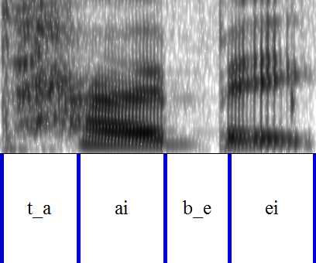
Introduction
Some useful information about labeling.
“sil” for silence.
“sp” for short pause.
fricative/affricate initials do not contain voicing parts.
plosive initials contain closure or aspiration period.

Slide 6
Some files you need
Phonetic class table (聲韻母表): http://speech.ee.ntu.edu.tw/homework/DSP_HW2-2/phonetic_class.pdf
Syllable table (標註模式): http://speech.ee.ntu.edu.tw/homework/DSP_HW2-2/syllable.txt
Audio data & FAQ: http://speech.ee.ntu.edu.tw/homework/DSP_HW2-2/

Slide 7
Praat
Download http://www.fon.hum.uva.nl/praat/
How to read a wave file
How to use it
How to label

Slide 8
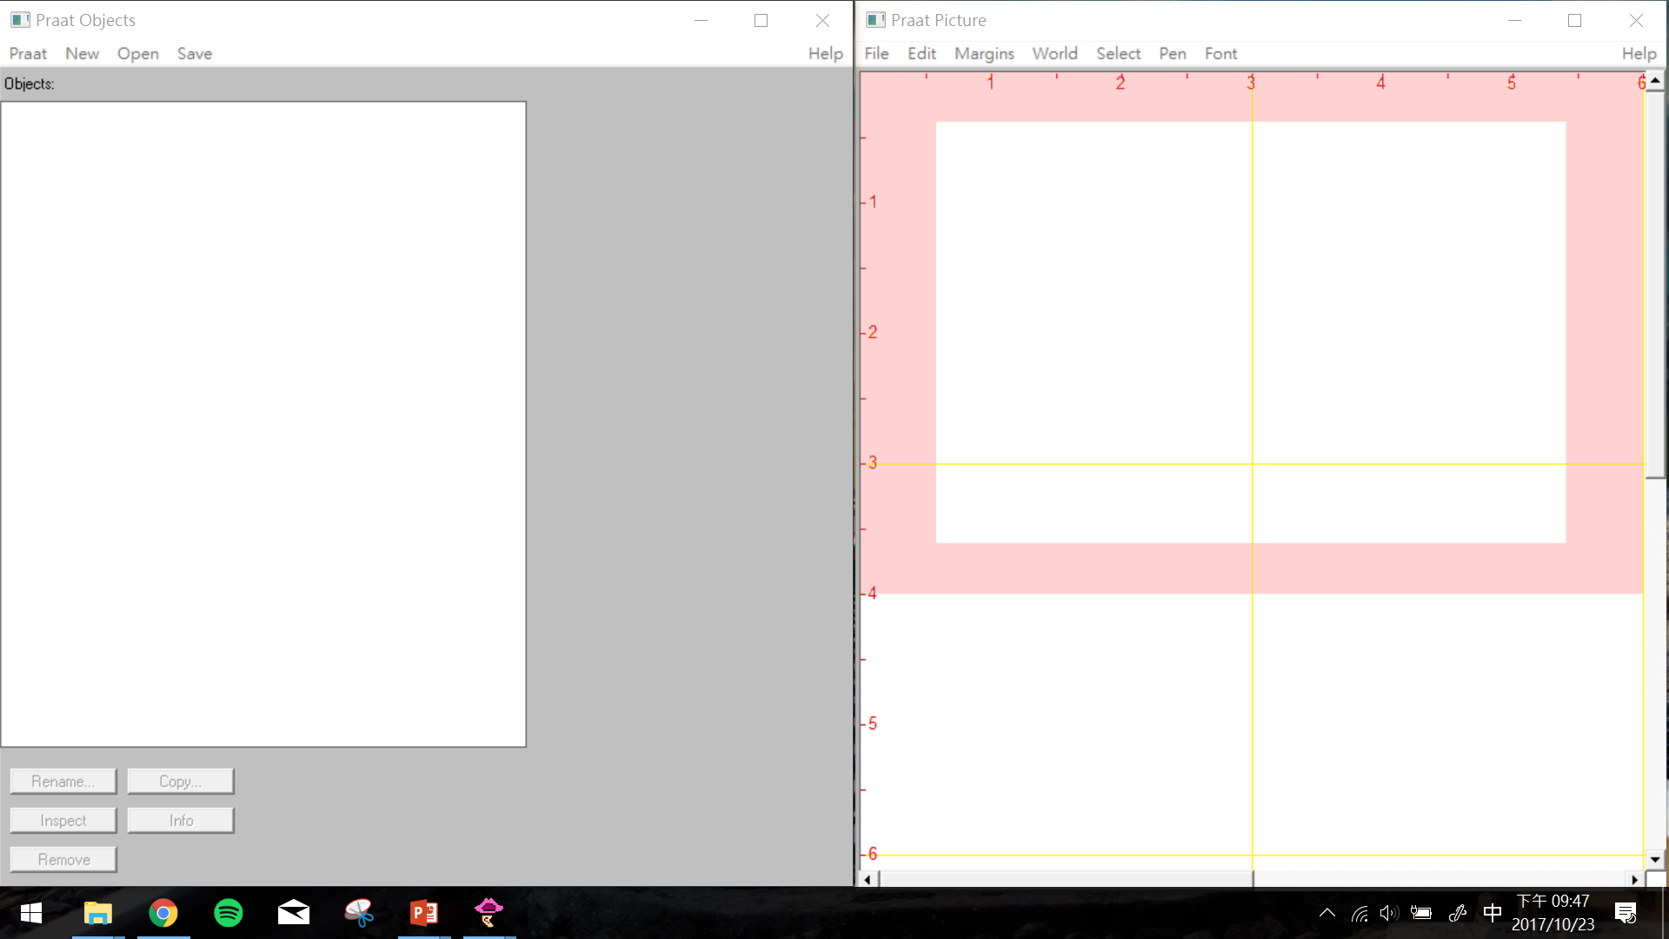
Praat

Slide 9
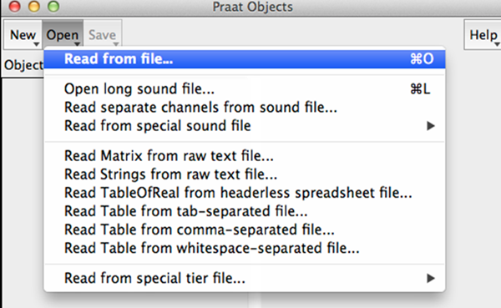
Praat - Read from file (.wav file)

Slide 10
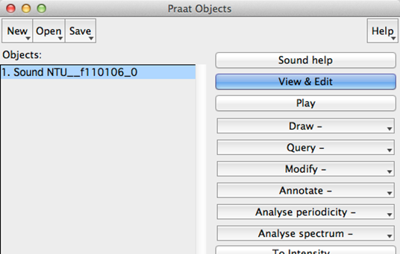
Praat - click View & Edit

Slide 11
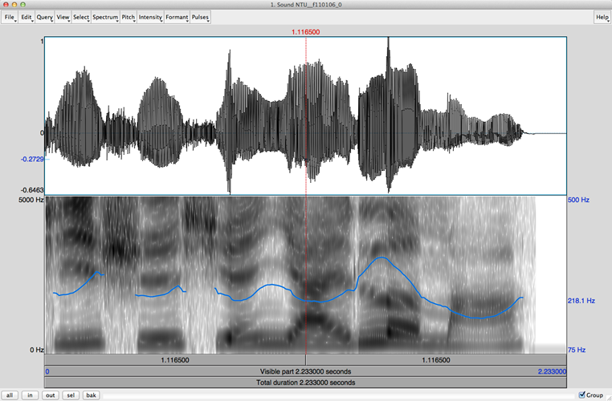
Praat - Time and Frequency Domain

Slide 12
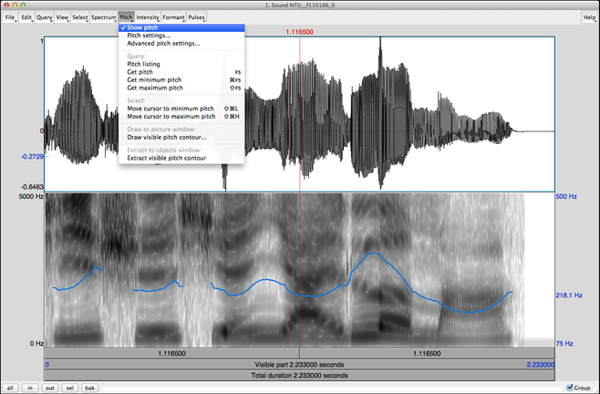
Praat - Pitch 音高 ( pitch -> Show pitch )

Slide 13
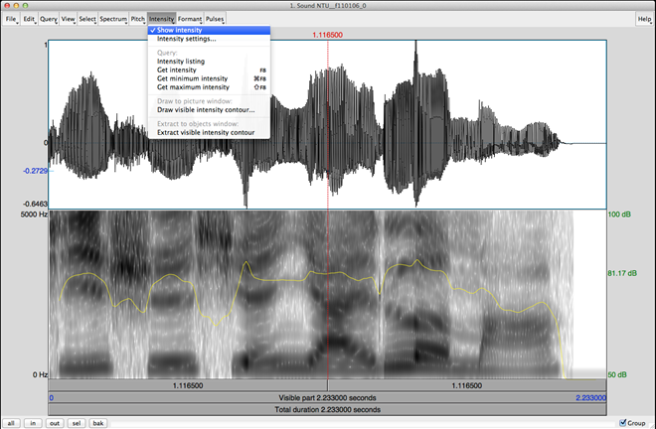
Praat - Intensity 音量( Intensity ->Show Intensity )

Slide 14
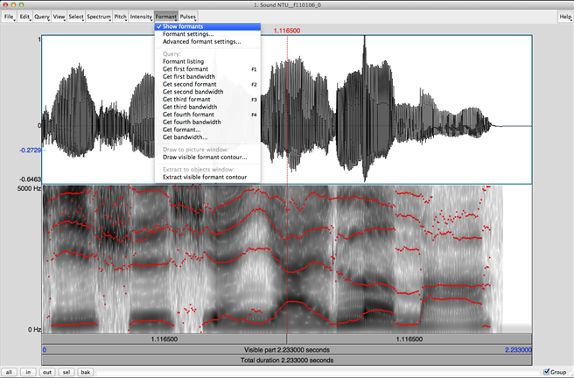
Praat - Formant 共鳴 (Formant -> Show formants)

Slide 15
Praat - Reminder
Intensity: power of all frequency components Two acoustic signals may have the same intensity but different frequency components.
Formant: acoustic resonance, measured by the peak in the frequency spectrum You should not trust the formant detection output for unvoiced initials.

Slide 16
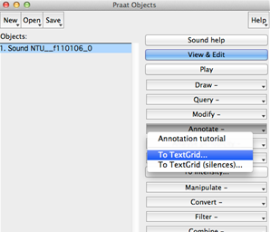
Praat - Label a wave file (Annotate -> To TestGrid)
1.
2.

Slide 17
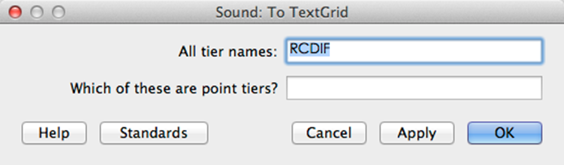
Praat - Label a wave file
Create one interval tier named RCDIF
No point tiers

Slide 18
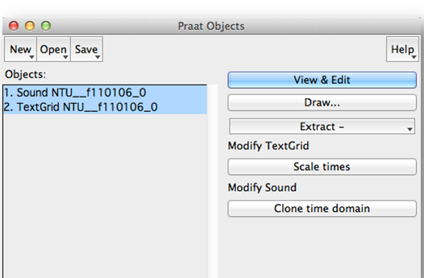
Praat - Label a wave file
With BOTH objects selected
click View & Edit

Slide 19
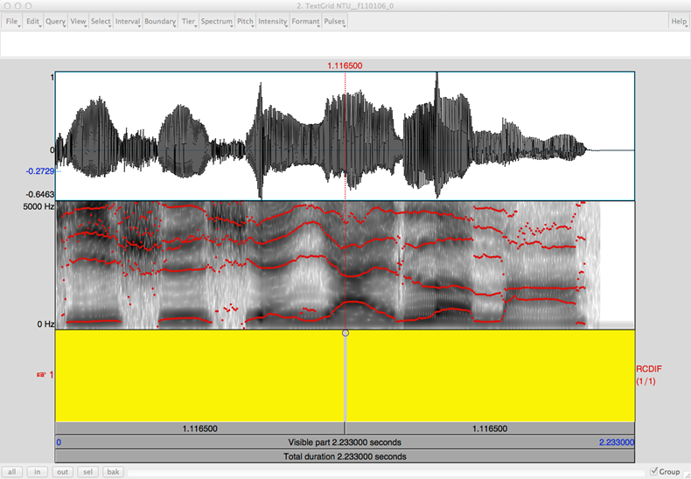
Praat - Label a wave file

Slide 20
Praat - Label a wave file
Click on spectrogram for your boundary
Add the boundary by clicking the small circle Remove by choosing “Boundary/Remove”
Drag you boundaries to be more accurate
Click between your boundary and type in your label (according to the “Syllable table”) Listen to your label by clicking the number (interval time) below it

Slide 21
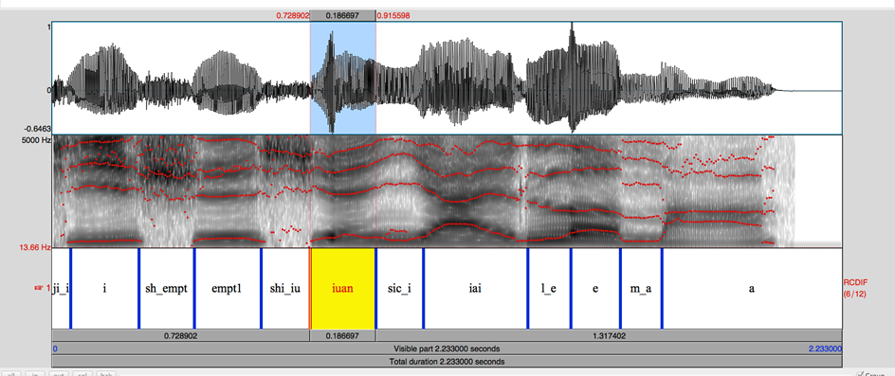
Praat - After labeling

Slide 22
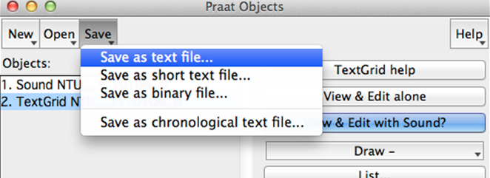
Praat - Save your Label file
Save your TextGrid object as short text file File should be “.TextGrid” not “.Collection”

Slide 23
Report - Part 1 (20%)
Choose your wave files from directories according to your student ID (https://goo.gl/ero6Ka).
You must submit at least 5 fully labeled TextGrid files (along with their wave files).
These 5 files should contain the initial/final labels you use in part 2.

Slide 24
Report - Part 2 (30%)
Choose at least 2 initials from the 4 classes (Plosive, Fricative, Affricate, Nasal)
For each of these 8 initials, create a table that contains at least 2 screenshots of its label.
Please show intensity and formant.

Slide 25
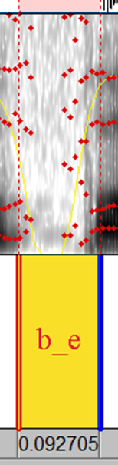
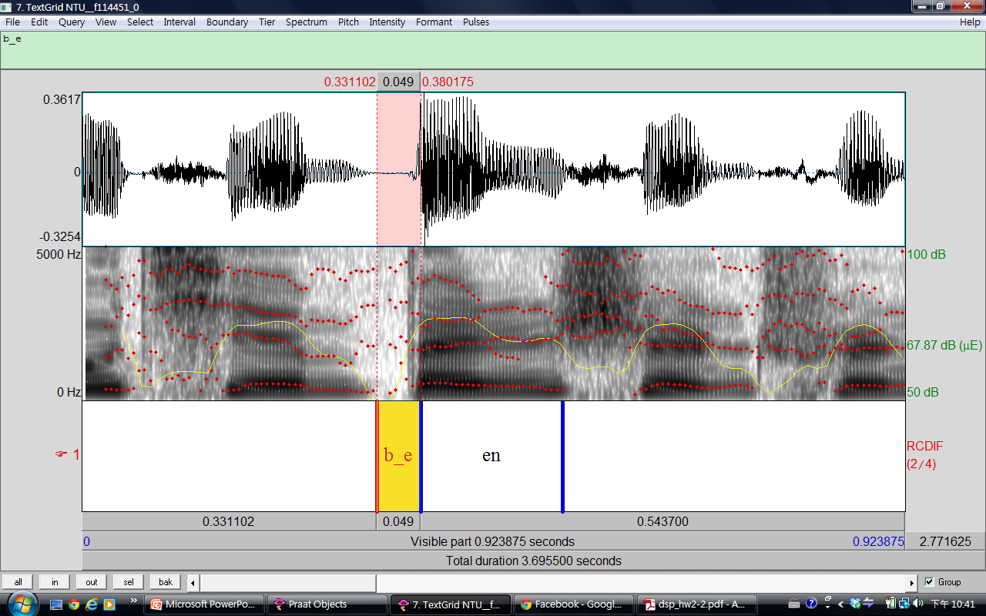
Part 2 - example：Plosive b (ㄅ)
Phonetic Class
Plosive | b(ㄅ)

Slide 26
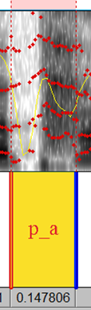
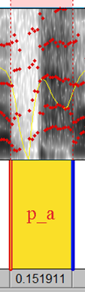
Part 2 - example：Plosive p (ㄆ)
Phonetic Class
Plosive | pp(ㄆ)

Slide 27
Part 2 - Useful tips
Zoom in and Zoom out.
show all or selection part in Praat by clicking the buttons on the lower-left corner of spectrograms.
In your chosen directory. “NTU_XXXXX_phn2file” lists all files containing each phone “NTU_XXXXX_file2phn” lists all phones contained in each file

Slide 28
Report - Part 3 (50%)
(20%) What are the consistencies of the spectrogram in each phonetic class? (Plosive, Fricative, Affricate, Nasal)
(10%) Is the boundary between neighboring initial and final clear? What is the benefit of using “right-context dependent” initial model (ex: sh_a) instead of pure initial model (ex: sh) to model initials?

Slide 29
Report - Part 3 (50%)
3. (10%) What are the differences when pronouncing ㄅ & ㄆ? How can you tell the differences in spectrogram for ㄅ & ㄆ? (You may also want to compare ㄉ & ㄊ, ㄍ & ㄎ respectively) 4. (10%) Take a look at the spectrogram of finals. Is there any simple rules to discriminate initials from finals provided only spectrogram?

Slide 30
Report - Bonus (10%)
The following is a speech analysis plot for a Chinese word composed of 4 characters. Each character is composed of an initial and a final.
Guess what the word is and describe your reasoning. (Score: reasoning 8%, correct answer 2%)
If you cannot figure out the word, you can guess the phonetic class or initial/finals. For example, your answer can be “l_i, i, sic_a, au” or “plosive, diphthong, plosive, monophthong”.

Slide 31
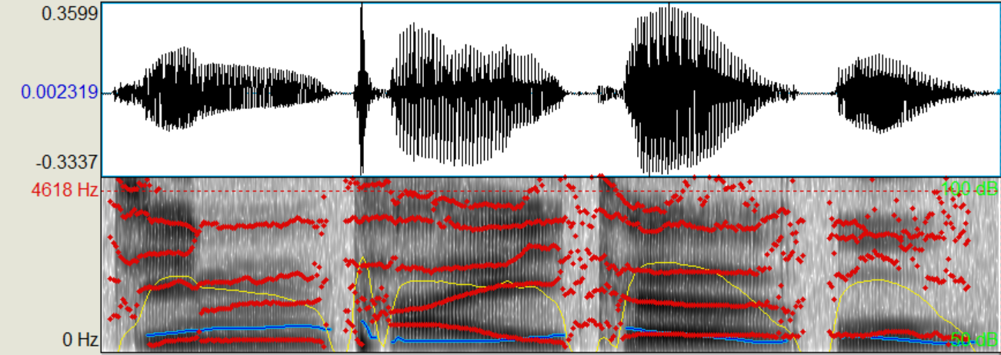
Report - Bonus (10%)
Hint: it’s a movie name which published in 2017 (sequel) !

Slide 32
Submission Requirements
5 TextGrid files (each along with its wave file). the “.TextGrid” & “.wav” filenames should be the same.
1 report (in PDF format). the filename should be hw2-2_bXXXXXXXX.pdf (your student ID).

Slide 33
Submission Requirements
3. Put those 11 files in a folder, compress the folder to 1 zip file and upload it to ceiba. ● Folder name should be hw2-2_bXXXXXXXX (e.g. hw2-2_b02901000) ● .zip or .tar.gz only ● 20% of the final score will be taken off for wrong format

Slide 34
If you have any problem…
Look up the Praat introduction website. http://www.fon.hum.uva.nl/praat/manual/Intro.html
Contact the TA : email：ntudigitalspeechprocessingta@gmail.com title: [HW2-2] bxxxxxxxx (your student number)

Slide 35
Homework 2
Your can submit either HW 2-1 (HMM Training and Testing) HW 2-2 (Speech Analysis)
You can also submit both
The higher grade of the two will count as your final score for HW2
Deadline: To be discussed
10% of the final score will be taken off for each day of late submission

